Slide 1


Customer Hub Slides

Slide 2

What is Customer Hub
Customer Hub is a self service tool that allows us to provide you
with exceptional customer support. On the Customer Hub, you
will be able to:
Open new tickets
View your open/closed tickets
View open/closed tickets for your organization
Post Screen Recordings and Video Recordings to tickets
View Knowledge Base and Wiki Articles
Engage in a forum called Community
View your Product information
Initiate a Chat with one of our Support Representatives

Slide 3
What's new in Customer Hub and its benefits
Wiki:
The Wiki feature adds a very powerful knowledge management capability to TeamSupport. You can collaborate on articles which include images and documents that can be shared internally in your organization, externally via the Hub, or to the entire world.
Our Knowledge Base and Wiki sections are meant to provide you with announcements, tips and tricks, new features, usage instructions, and anything else that will be helpful resource to you. The Knowledge Base and Wikis can be found on the Landing Page or on the top navigation. We encourage you to browse or Knowledge Base and Wiki to stay informed and up to date on our offerings.

Slide 4
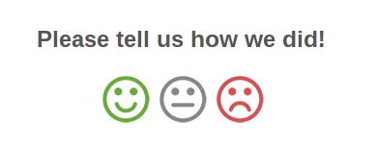
Agent Rating
If your ticket is closed by a member of our team, either after you’ve updated it signing off or due to inactivity, you will receive an email notification. At the bottom of the email, you’ll have an opportunity to leave feedback on how you feel your request was handled.
Please take a moment and click on one of the face icons - Happy, Neutral, or Unhappy. A new page will load in your web browser where you can leave an optional comment. We encourage and value your feedback.

Slide 5
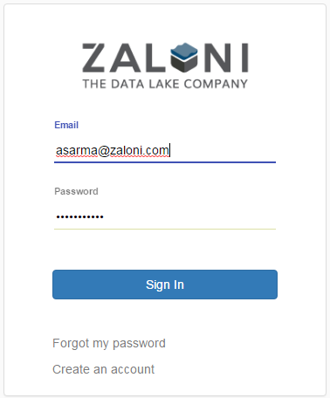
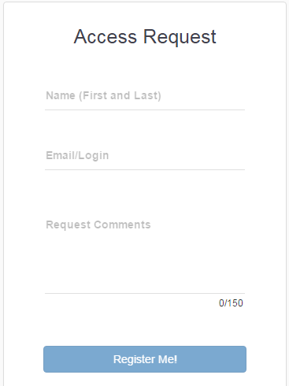
How to request Support portal access
Step:1 Click on 'Create an account'.
Step:2 Add comment why you need access to Zaloin Support portal.

Slide 6
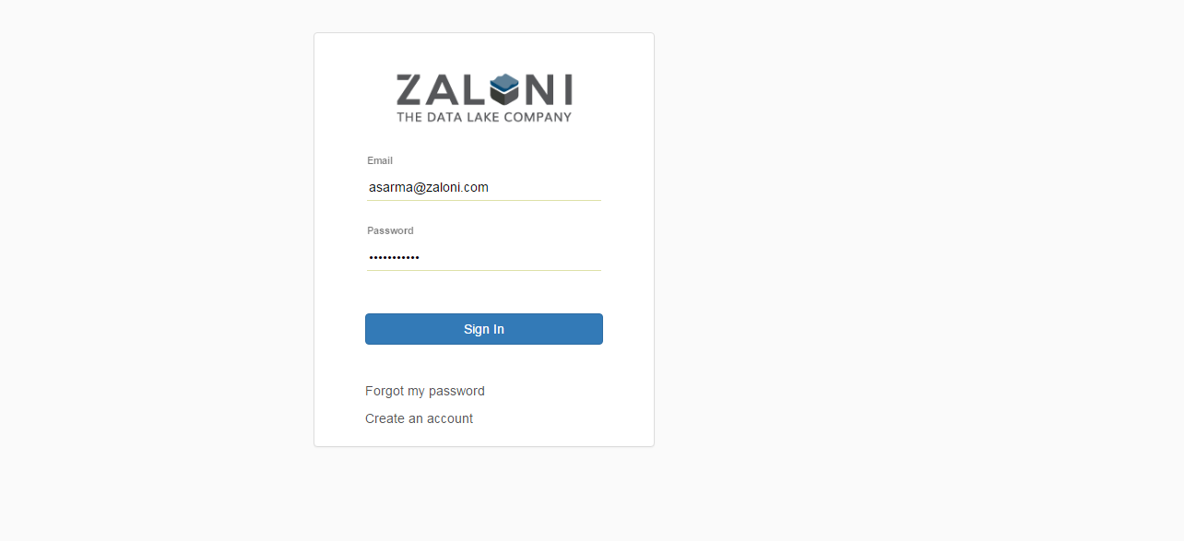
How to login to Customer Hub
Login to support.zaloni.com

Slide 7
Password Reset
Enter your email address, then the click ‘Forgot my password’ link. A temporary password will be sent to you. Enter this temporary password, and you will then be prompted to create a new password.

Slide 8
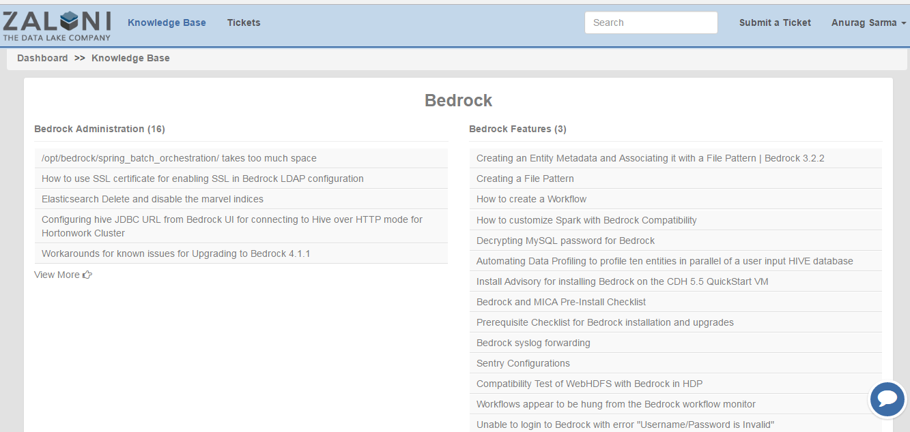
How to use Customer Hub
How to view Knowledge Base

Slide 9
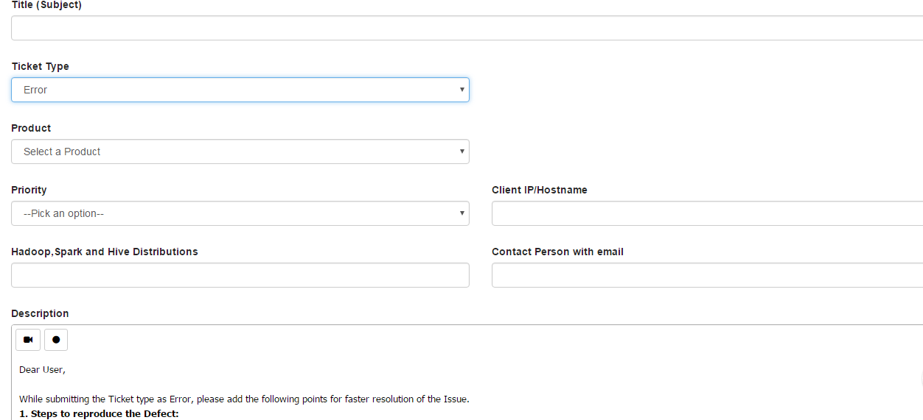
How to open a ticket

Slide 10
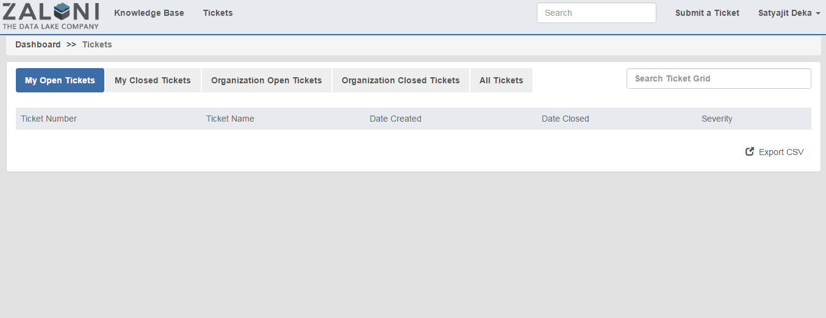
How to view your open tickets

Slide 11
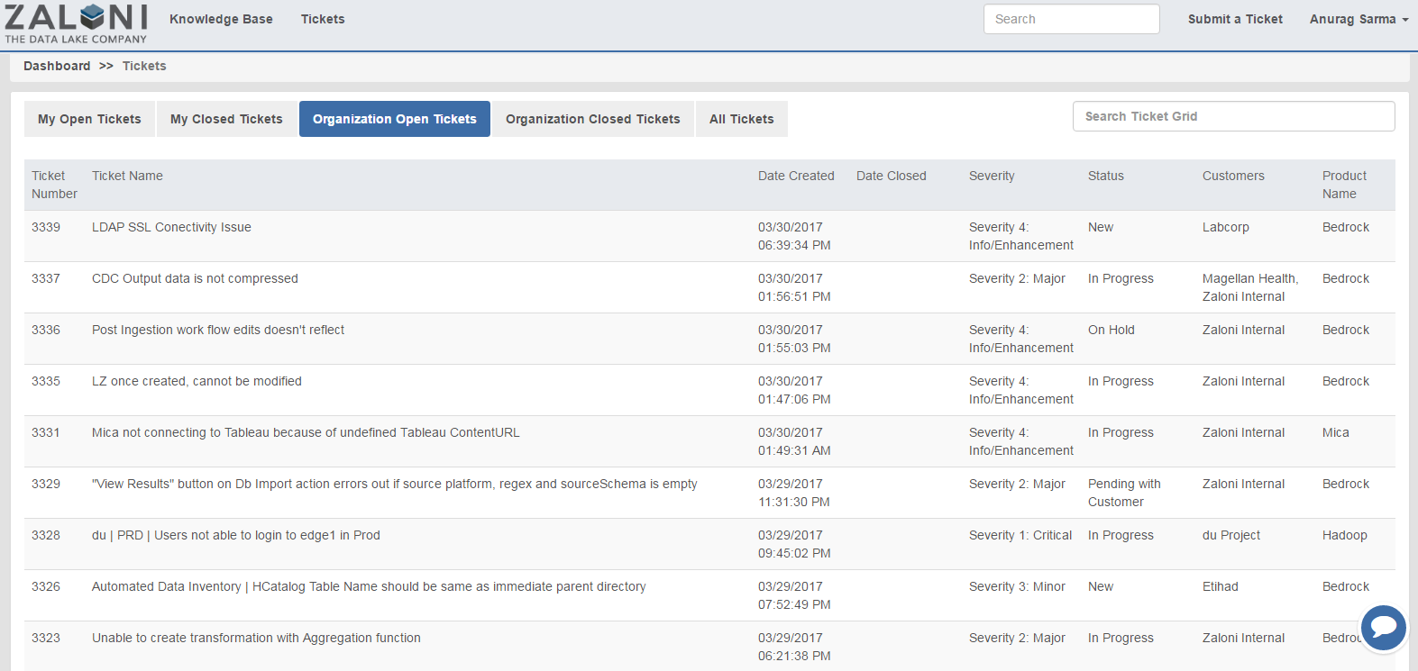
How to view your Organization open tickets

Slide 12
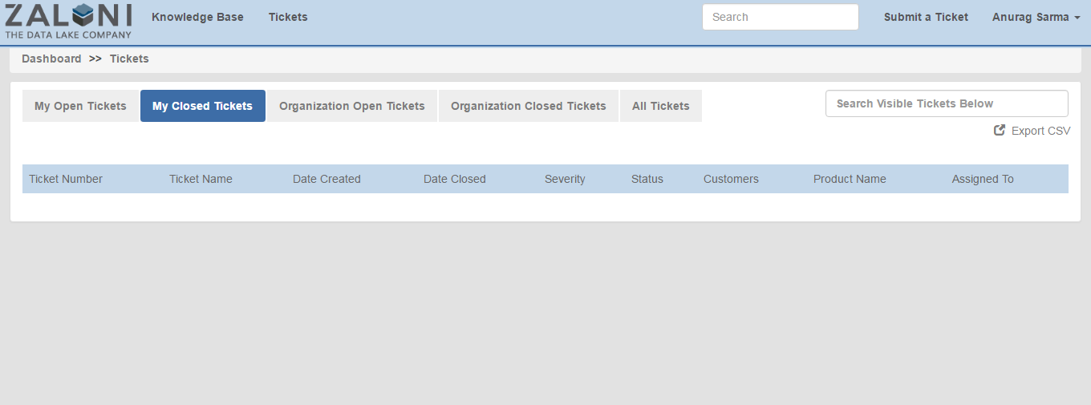
How to view Organization closed tickets

Slide 13
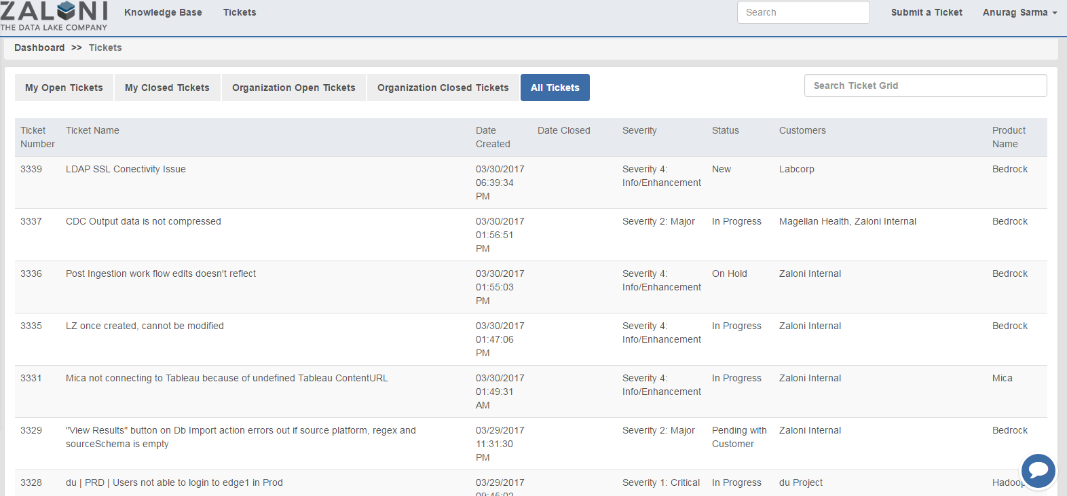
How to view All tickets

Slide 14
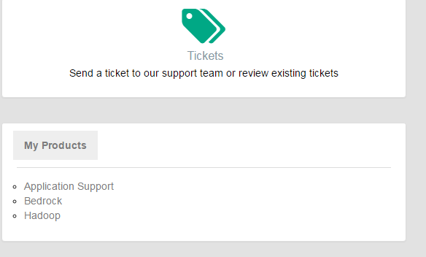
How to see a Product

Slide 15
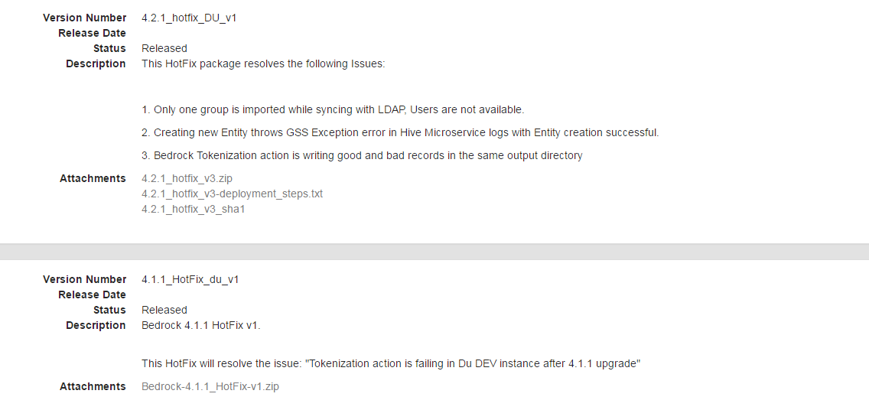
How to see a Product Version

Slide 16
THANK YOU
Zaloni Confidential and Proprietary - Provided under NDA

